Slide 1
Online Edu. Employment (Android)
Project Plan
VEL team
14 Aug. 2015

Slide 2
Project Plan
Agenda
1. Team VEL
2. Product Owner
3. Project Goal & Major Capability
4. Product Backlog
5. Development Plan
6. Scrum PM Tool
7. One User Story
8. Risk Management

Slide 3
1. Team VEL

Slide 4
2. Product Owner

Slide 5
3. Project Goal and Major Capability

Slide 6
4. Product Backlog

Slide 7
5. Development Plan

Slide 8
6. Scrum PM Tool

Slide 9
7. One User Story
User story #1
As visitor, when I use mobile devices (phones and pads) to access the website, I want to see that the framework (the header, footer and buttons) of this website is suitable for my using behavior on mobile devices
So that I can use this website on mobile devices as convenient as on PCs.

Slide 10
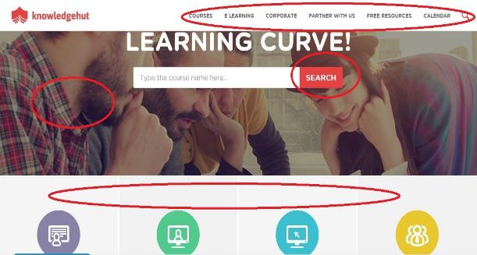
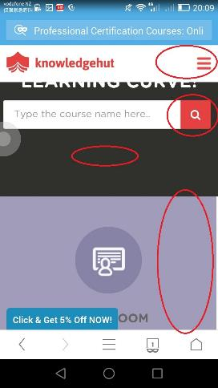
7. One User Story
The menu, button, picture and layout may change from PC to phones.

Slide 11
7. One User Story
User story #1
As visitor, when I use mobile devices (phones and pads) to access the website, I want to see that the framework (the header, footer and buttons) of this website is suitable for my using behavior on mobile devices
So that I can use this website on mobile devices as convenient as on PCs.
Device type detection
DPI & resolution detection
Dynamically changing style

Slide 12
8. Risk Management

